Slide 1
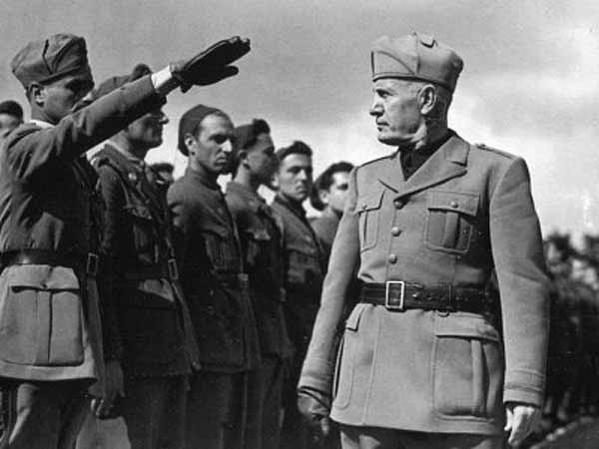
Lesson 4 Aggressors Invade Nations

Slide 2
Setting the Stage
By the mid-1930s, Germany and Italy seemed bent on military conquest. The major democracies –Britain, France and, the United States- were distracted by economic problems at home and longed to remain at peace. With the world moving toward war, many nations pinned their hopes for peace on the League of Nations. As fascism spread in Europe however, a powerful nation in Asia moved toward a similar system. Following a period of reform and progress in the 1920s, Japan fell under military rule.

Slide 3
#5a Answer the questions based on the timeline.
1931 Japan Invades Manchuria. → Why did the Japanese invade Manchuria?
1935 Mussolini invades Ethiopia. U.S. Congress passes first of three Neutrality Acts. → Why did Britain and France take no action against Italian aggression? Why did isolationists want these laws passed?
1936 German troops move into the Rhineland. → What were some effects of appeasing Hitler after his invasion of the Rhineland?

Slide 4
#5b
Japan invades China. Hitler plans to absorb Austria and Czechoslovakia in the Third Reich. → What were the immediate results of the invasion?
Munich Conference is held. → Why was the Munich Conference unsuccessful?
1939 Franco becomes Spanish dictator. Germany and Russia sign a nonaggression pact. → Why did Stalin sign an agreement with fascist Germany, once a bitter enemy?

Slide 5
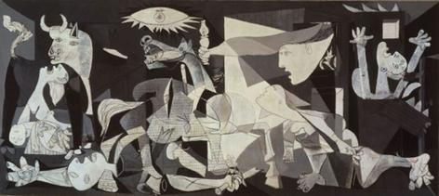
Guernica –Pablo Picasso (1937)

Slide 6
#6 Critical Thinking
Answer:
What were Picasso’s probable motives for painting Guernica? See Pg. 513
What feelings do you think Guernica stirred in the public in the late 1930s?
What was the major weakness of the League of Nations? Pg. 508
Why did Churchill believe that Chamberlain’s policy of appeasement was a defeat for the British? Pg. 514
What similar goals did Hirohito, Mussolini, and Hitler have in common?

