Slide 1
Lesson 2 Judeo-Christian Tradition
The Big Idea:
Judaism and Christianity taught individual worth ethical values, and the need to fight injustice.
Why it Matters Now:
These ideals continue to be important to democracy today.

Slide 2
Judaism
The story of the Israelites begins in the Torah, the Jews most sacred text, with a man named Abraham
Abraham lived near Ur in Mesopotamia (Iraq).
About 2000 B.C., Abraham and his family migrated, herding sheep and goats westward into a region called Canaan (Palestine/Israel).
Abraham founded the Israelite nation near the eastern Mediterranean coast.

Slide 4
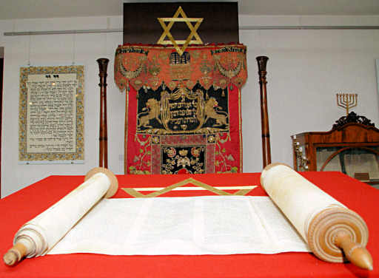
The Torah

Slide 5
The Torah
Torah means “instruction” in Hebrew.
The Israelites developed The Torah as a record of God’s teachings.
They believed in one God, monotheism.
The Torah consists of 5 books
1. Genesis 2. Exodus 3. Leviticus
4. Numbers 5. Deuteronomy
God’s teachings set a strict moral standard for the Jews.

Slide 6
Judaism
The Hebrew Bible (the Old Testament) states that human beings were created in God’s image.
Judaism interpreted this to mean that each human being has a divine spark that gives him or her dignity that can never be taken away.
For the Greeks and Romans, the individual had dignity because of his or her ability to reason.
In Judaism, each person had dignity by being a child of God.
God gave the Israelites moral freedom, or the capacity to choose between good and evil.
Each person is responsible for the choices he or she makes, leading to a new emphasis on the worth of the individual.

Slide 7
The Ten Commandments
In the book of Exodus, Moses and the Israelites stopped at Mount Sinai on their way from Egypt to Canaan.
At Mount Sinai, God gave Moses the Ten Commandments, a set of ten basic moral laws.
Moses became the “lawgiver” to the Jews.
Unlike the laws of other peoples, the Jewish code focused more on morality and ethics and less on politics.
The code included rules of social and religious behavior to which even rulers were subject.

Slide 8
Document Based Investigation #4a
Read Pg. 15: Historical Source
Exodus 20:2-14
The Ten Commandments
Analyze Historical Sources:
Do the first four commandments concern themselves more with the Hebrews’ relationship with God or with one another?
What do the last six commandments have in common that distinguish them from the first four?

Slide 9
Reading Check
#4b
Read pg. 15 -16
Answer:
What did the prophets teach about injustice and oppression?

Slide 10
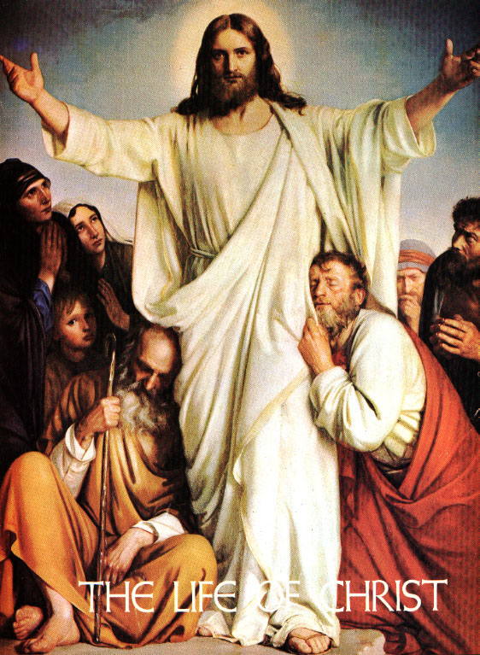
Christianity

Slide 11
The New Testament
Jesus of Nazareth was born around 6 to 4 BCE. in Bethlehem.
He was both a Jew and a Roman subject.
He began his public ministry around age 30.
His preaching contained many ideas from Jewish tradition, such as monotheism and the principles of the Ten Commandments.

Slide 12
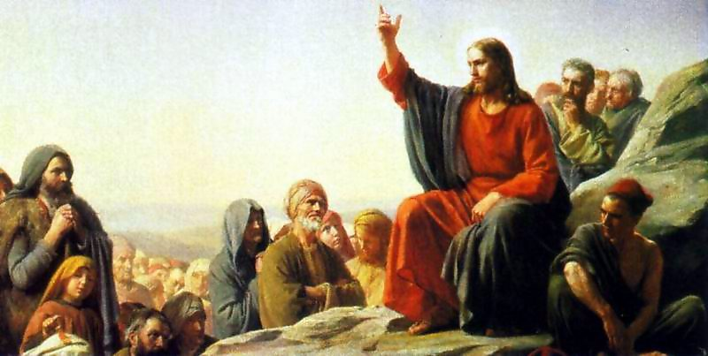
Sermon on the Mount Recorded by Matthew: Jesus ethical message of mercy and sympathy for the poor and helpless.

Slide 13
Outline: Guided Reading
#5a Read Pg. 16 to 18 and complete the guided reading outline.
I. The Teachings of Christianity
A. Jesus’ Ideas
1.
2.
3.
B. Jesus visited Jerusalem
1.
2.
3.

Slide 14
II. The Spread of Christianity
A. In the first century after Jesus’ death
1.
2.
3.
B. Rome Spreads Judeo-Christian Ideas
1.
2.
3.
III. Rome’s Christian Legacy
A. Rome’s Christian Legacy
1.
2.

Slide 15
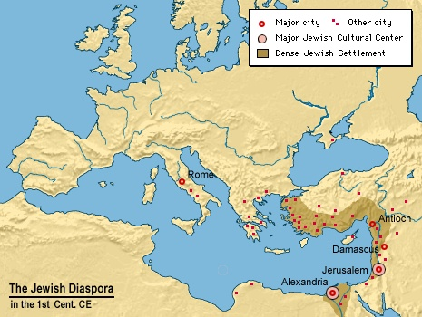
The Jewish Diaspora in the 1st Century CE

Slide 16
Islam
#5b
Read pg. 18 - Islam
Answer:
1. What values did Muhammad emphasize in his teachings?

Slide 17
#6 As you read about religious traditions and reactions to them, fill in the chart to identify the democratic ideas that arose from each.
Religion/Movement | Influence on the Rise of Democratic Ideas
1. Judaism (pg. 14) | 1. 2.
2. Christianity (pg. 16) | 1. 2.
3. Islam (pg. 18) | 1. 2.
Renaissance (pg. 19) | 1. 2.
5. Reformation (pg. 19) | 1. 2.

