Slide 1
Lesson #3 The Enlightenment Spreads
The Big Idea
Enlightenment ideas spread through the Western world and profoundly influenced the arts and government.
Why it Matters Today
An “enlightened” problem-solving government and society prevails in modern civilization today.

Slide 2
Setting the Stage
The philosophes’ views about society often got them in trouble.
In France, it was illegal to criticize either the Catholic Church or the government.
Many philosophes landed in jail or were exiled.
Nevertheless, the Enlightenment spread throughout Europe with the help of books, magazines, and word of mouth.

Slide 3
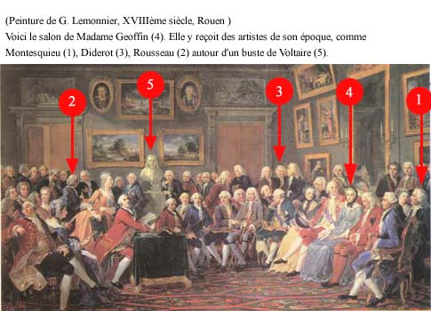
A World of Ideas

Slide 4
Salons
Salons were informal social gatherings at which writers, artists, philosophes, and others exchanged ideas.
Paris was the cultural and intellectual capital of Europe.
The buzz of Enlightenment ideas was most intense in the mansions of several wealthy women of Paris.
The most influential salon hostess was Marie-Therese Geoffrin, who helped finance the publication of Denis Diderot’s large set of books called Encyclopedia.

Slide 5
Diderot’s Encyclopedia
The first volumes were published in 1751.
The Enlightenment views in these articles angered both the French government and the Catholic Church.
Their censors banned the work because they felt it undermined royal authority and encouraged a spirit of revolt.
Nonetheless, Diderot continued to publish his Encyclopedia (Freedom of the press).
The salons and Encyclopedia helped spread Enlightenment ideas to educated people all over Europe.
As a result they began to spread through newspapers, pamphlets, and even political songs.

Slide 6
New Artistic Styles
The Enlightenment ideals of order and reason were reflected in the arts – music, literature, painting, and architecture.
European art in the 1600s and early 1700s were dominated by the style called baroque.
Under the influence of the Enlightenment, style began to change.
Artists and architects worked in a simple and elegant style that borrowed ideas and themes from classical Greece and Rome, known as neoclassical.

Slide 7
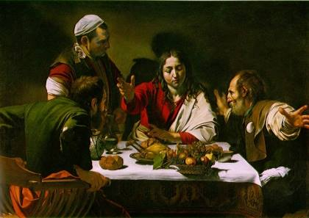
Baroque Art
Caravaggio,
Supper at Emmaus
1601
Baroque art is less complex and more realistic. The
movement was encouraged by the Catholic Church as a return to tradition and spirituality.

Slide 8
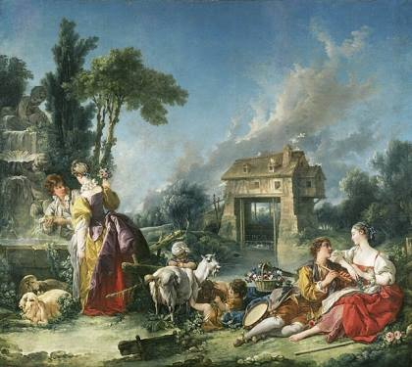
Rococo Art
Francois Boucher
The Fountain of Love
1748
Characterized by elegant, refined yet playful subject matters. Decorative designs were used to illustrate stories.

Slide 9
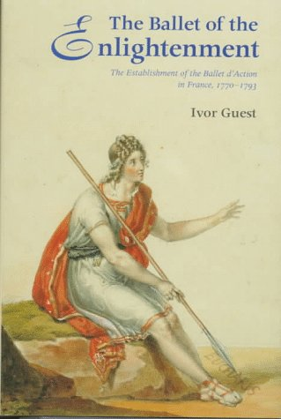
The Enlightenment Inspires Composers
The new Enlightenment ideals led composers and musicians to
develop new forms of music
(baroque to rococo).
An elegant style of
“classical” emerged.
Ballets, operas were performed for the social elite.
Mozart, The Musical Genius

Slide 10
#5
As you read about the spread of ideas during the Age of Reason, explain how each of the following people reflected Enlightenment ideas.
Mary Astell Pg. 170 | 1. 2.
Mary Wollstonecraft Pg. 170 | 1. 2.
Frederick the Great Pg. 171 | 1. 2.
Joseph II Pg. 172 | 1. 2.
Catherine the Great Pg. 172 | 1. 2.

Slide 11
#6 Assessment
Reading Check
Why did the Catholic Church seek to censor the writings of Enlightenment thinkers? Pg. 167-68
How did baroque and neoclassical architecture differ? Pg. 168
Why do you think the issue of education was important to both Astell & Wollstonecraft?
Pg. 170
How accurately does the term “enlightened despot” describe Catherine the Great? Explain. Pg. 172
Why did the Enlightenment not have much impact of the lives of poorer Europeans? Pg. 175

